Slide 1


Hackathon 2021: Rigetti Challenge - Quantum Machine Learning (QML) for COVID-19
QML – What we expect
Improvements in run-time
Improvements in learning capacity
Improvements in learning efficiency

Slide 2
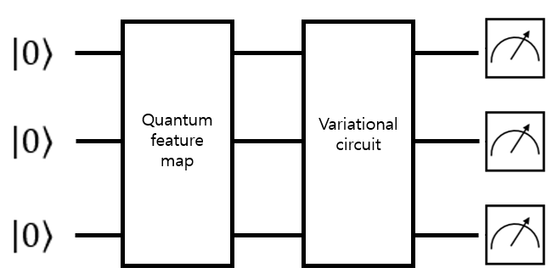
The process of what our team did is..
COVID-19 data
 | Series1_NHBE_Mock_1 | Series1_NHBE_Mock_2 | Series1_NHBE_Mock_3 | Series1_NHBE_SARS-CoV-2_1 | Series1_NHBE_SARS-CoV-2_2 | Series1_NHBE_SARS-CoV-2_3
DDX11L1 | 0 | 0 | 0 | 0 | 0 | 0
WASH7P | 29 | 24 | 23 | 34 | 19 | 44
FAM138A | 0 | 0 | 0 | 0 | 0 | 0
FAM138F | 0 | 0 | 0 | 0 | 0 | 0
OR4F5 | 0 | 0 | 0 | 0 | 0 | 0
LOC729737 | 112 | 119 | 113 | 127 | 84 | 270
LOC100132287 | 0 | 0 | 0 | 0 | 0 | 0
LOC100132062 | 0 | 0 | 0 | 0 | 0 | 0
LOC100133331 | 19 | 21 | 36 | 16 | 23 | 54
OR4F29 | 0 | 0 | 0 | 0 | 0 | 0
OR4F16 | 0 | 0 | 0 | 0 | 0 | 0
OR4F3 | 0 | 0 | 0 | 0 | 0 | 0
LOC100288069 | 13 | 17 | 27 | 19 | 9 | 50
LINC00115 | 9 | 12 | 26 | 12 | 7 | 28
FAM41C | 0 | 0 | 1 | 0 | 1 | 0
SAMD11 | 11 | 20 | 8 | 26 | 10 | 63
NOC2L | 1773 | 1757 | 2554 | 1915 | 1605 | 5162
… | … | … | … | … | … | …
Dimension reduction (PCA)
embedding
training

Slide 3
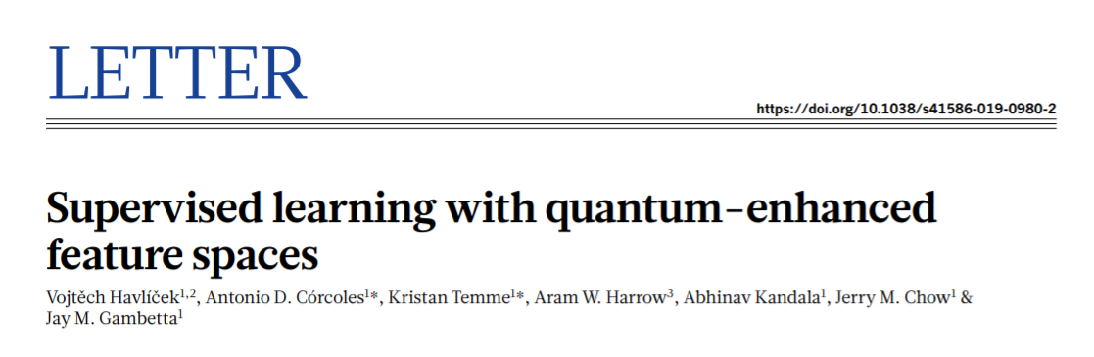
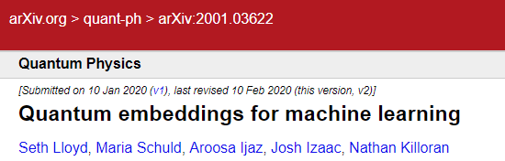
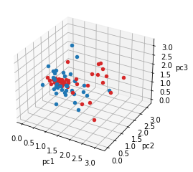
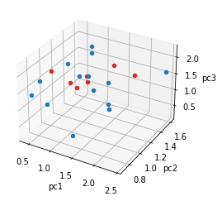
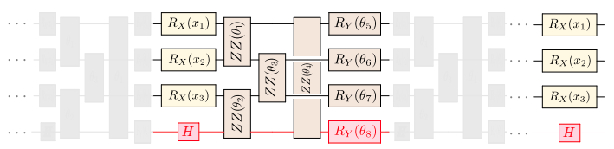
The process of what our team did is..
COVID-19 data
 | Series1_NHBE_Mock_1 | Series1_NHBE_Mock_2 | Series1_NHBE_Mock_3 | Series1_NHBE_SARS-CoV-2_1 | Series1_NHBE_SARS-CoV-2_2 | Series1_NHBE_SARS-CoV-2_3
DDX11L1 | 0 | 0 | 0 | 0 | 0 | 0
WASH7P | 29 | 24 | 23 | 34 | 19 | 44
FAM138A | 0 | 0 | 0 | 0 | 0 | 0
FAM138F | 0 | 0 | 0 | 0 | 0 | 0
OR4F5 | 0 | 0 | 0 | 0 | 0 | 0
LOC729737 | 112 | 119 | 113 | 127 | 84 | 270
LOC100132287 | 0 | 0 | 0 | 0 | 0 | 0
LOC100132062 | 0 | 0 | 0 | 0 | 0 | 0
LOC100133331 | 19 | 21 | 36 | 16 | 23 | 54
OR4F29 | 0 | 0 | 0 | 0 | 0 | 0
OR4F16 | 0 | 0 | 0 | 0 | 0 | 0
OR4F3 | 0 | 0 | 0 | 0 | 0 | 0
LOC100288069 | 13 | 17 | 27 | 19 | 9 | 50
LINC00115 | 9 | 12 | 26 | 12 | 7 | 28
FAM41C | 0 | 0 | 1 | 0 | 1 | 0
SAMD11 | 11 | 20 | 8 | 26 | 10 | 63
NOC2L | 1773 | 1757 | 2554 | 1915 | 1605 | 5162
… | … | … | … | … | … | …
Dimension reduction (PCA)
Quantum embedding (Pauli feature map)
Training dataset
Test dataset
Machine learning

Slide 4
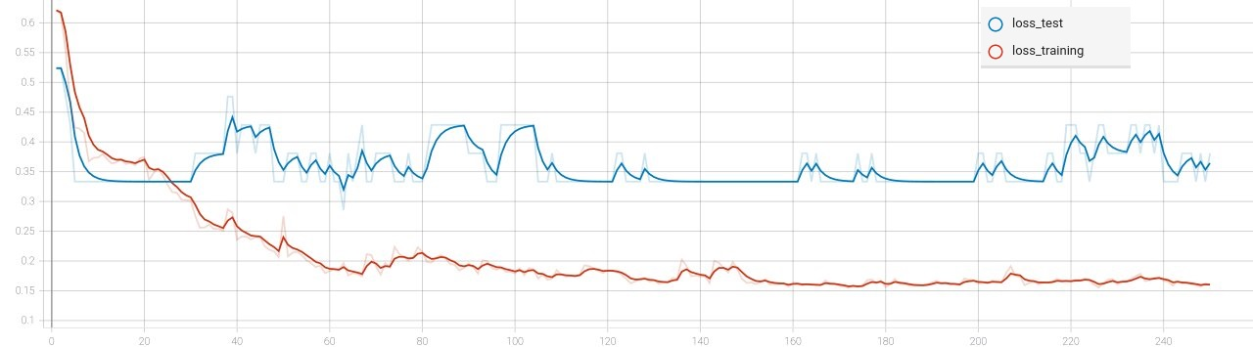
Result: Loss plot
Unfortunately, overfitting..
How to prevent overfitting
Cross-validation
Train with more data
Remove features
Early stopping
Regularization
Ensembling
(https://elitedatascience.com/overfitting-in-machine-learning)

